Slide 1





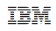









Operational Threat & Risk Information Sharing and Analytics
TEAM Threat
STIDS 2015

Slide 2
Tutorial high-level agenda
The problem we are trying to solve
The process for solving it
The (draft) threat/risk specification
Approach
Conceptual Model
Mappings (STIX, NIEM, NIST)
Approaches to leveraging and implementing threat/risk
This Presentation
Copyright © 2015 : OMG & Threat/risk submitters (Slide 22)
Slides may be used with attribution

Slide 3
Introductions
Cory Casanave
Model Driven Solutions, CEO
OMG Board of Directors
Threat/risk – Chief Architect
Please introduce yourself, your interest and affiliations.

Slide 4
Draft specification artifacts
Specification Document (PDF): http://tinyurl.com/qdfl6jl
http://www.threatrisk.org/spec/RevisedSubmission/Revised%20Operational%20Threat%20Risk%20Submission.pdf
Specification Document (.DOC): http://tinyurl.com/p6ykkrm
http://www.threatrisk.org/spec/RevisedSubmission/Revised%20Operational%20Threat%20Risk%20Submission.doc
Specification .ZIP with all models: http://tinyurl.com/o2vkkss
http://www.threatrisk.org/spec/RevisedSubmission/Revised%20threat-risk%20Submission%20machine%20readable%20files.zip
Web view of models: http://tinyurl.com/q29clvk
http://www.threatrisk.org/spec/Threat%20Risk%20Model.html
Community portal: http://threatrisk.org/
Download Now

Slide 5
Problem Space
There is a critical need to understand and mitigate threats and risks – to “connect the dots”.
The Landscape of threats is changing
Multiple attack vectors, cyber/physical and other
Advanced threats utilize multiple vulnerabilities
There are multiple communities addressing the same threats
Cyber/physical, emergency management, safety, defense, etc.
No comprehensive consistent semantic framework
Existing systems provide insular treatment of threat/risk relationships
Comprehensive system would allow system-of-systems interoperability (private/private, public/private)

Slide 6
We have critical needs for analytics and information sharing
Cyber
Crime
Terrorism
Critical Infrastructure
Natural
Disasters
Sharing & Analytics
Sharing & Analytics
Sharing & Analytics
Sharing & Analytics
Sharing & Analytics
Threat and risk
Identification, assessment, mitigation, situational awareness
Risks and threats from threat actors and natural sources cross domains
Yet the information sharing and analytics capabilities are stove piped

Slide 7
The Opportunity
Integrated threat and risk management across
Domains
Cyber, Criminal, Terrorism, Critical Infrastructure, Natural disasters, others…
Across network fabrics (e.g. classified, unclassified, open)
Products and technologies
Enterprise risk management, cyber tools, disaster planning, etc…
Organizations
Government (Global, National, State, Local, Tribal), Non-governmental organizations, Commercial
Leading to
Shared awareness of threats and risks
Federated information analytics (including “big data”)
Improved mitigation of threats and risk
Situational awareness in real time
Big data analytics
Ability to respond and recover

Slide 8
The Challenge
There are dozens of standards, exchange schema and technologies for each domain
Each uses different terminology, structure and schema to represent the same or overlapping concepts
These only work together inside of proprietary products. No one product could ever cover the entire scope
Organizations with different or multiple products can’t integrate
There is even less capability across domains
Threat actors and natural disasters don’t respect our stovepipes, they exploit them
Impact: Our capacity for coordinated mitigation and response is severely compromised

Slide 9
Primary classes of use cases
Transformation from one information sharing data format to another
Example: STIX Cyber Event to NIEM to a CAP Alert
Analytics of information federated from multiple sources
Examples:
Fusion center “connects the dots” between a stolen laptop (from NIEM) and a cyber incident (From STIX)
Bio hazard detected by automated instruments and collaborated by local health care professionals

Slide 10
What we need is an integrating framework that supports automated data mapping
Cyber
Crime
Terrorism
Critical Infrastructure
Natural
Disasters
Integrating Framework for Threats and Risks
Sharing & Analytics
Sharing & Analytics
Sharing & Analytics
Sharing & Analytics
Sharing & Analytics
An integrating framework that helps us deal with all aspects of a risk or incident
A federation of risk and threat information sharing and analytics capabilities

Slide 11
Approach
Highlight O(N) vs. O(N^2)
Cyber
Terrorism
Construct a conceptual model informed by existing schema, research and best practices
This conceptual model is independent of specific data structures, technologies and terminologies
Define mapping models between the conceptual model and purpose/technology schema
Make both models sufficiently precise that they can drive automated bridging between any mapped schema
Cyber
Cyber
Cyber
Disasters
Map/Bridge
Map/Bridge
Map/Bridge
Conceptual Model
Map/Bridge
Map/Bridge
Criminal
Cyber
Criminal
Infrastructure

Slide 12

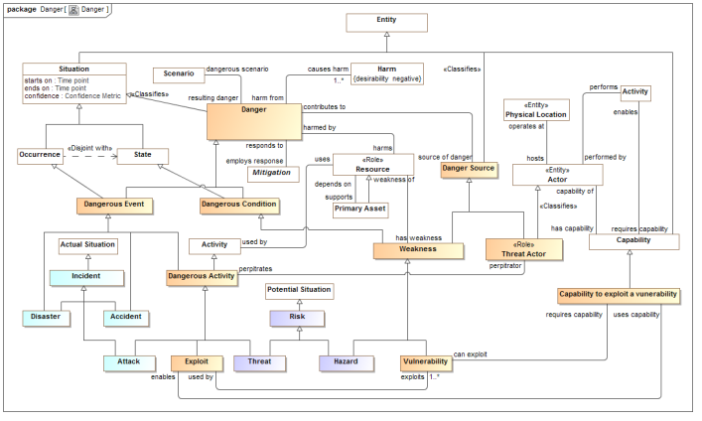
Conceptual Model Inputs
KDM
(Risk)
NIST Framework
Conceptual Model
NIEM
(General)
STIX
(Cyber)
OGC
(Geo)
EDXL
(Emergency)
FIBO (Finance)
SEI
(Safety)
CAL OES
(Health)
MAP
ISO
(Risk)
ISO
(Units)
RMS
(Custody)
STIX, NIEM, EDXL, Others
There is still more to do to fully integrate the above and we anticipate more inputs and use cases

Slide 13
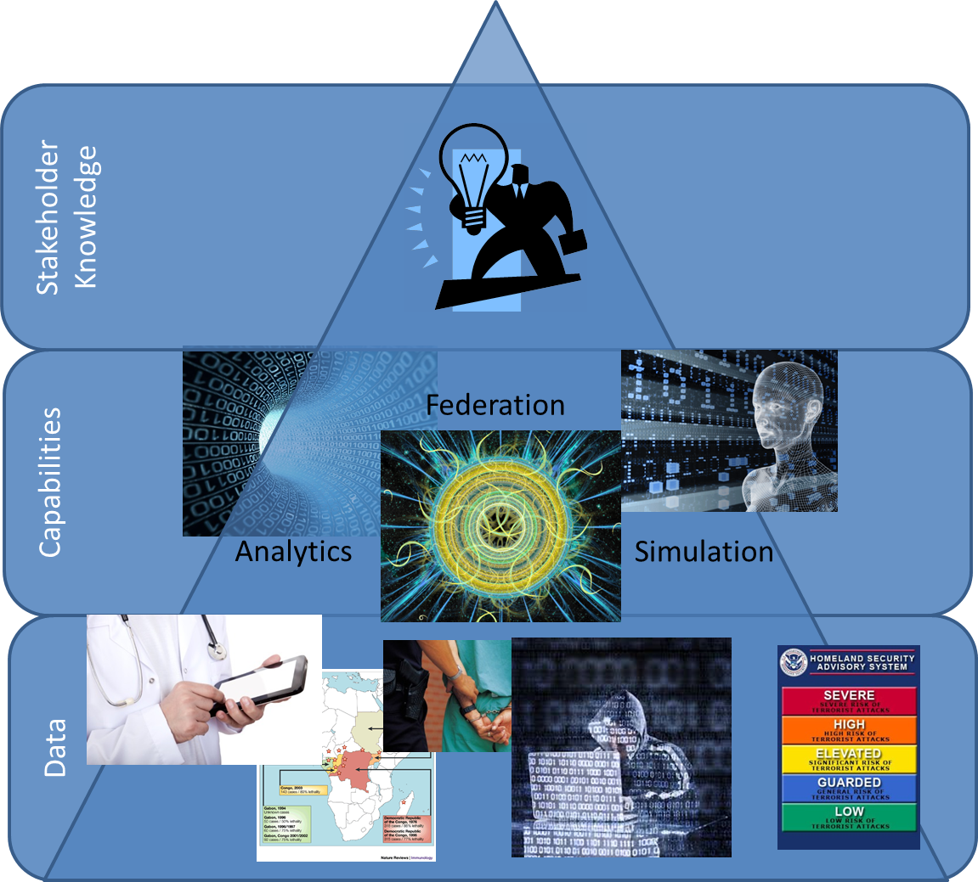
Data to knowledge

Slide 14
The Process
Building a community and standards to protect against threats and risks

Slide 15

It takes a community
Threat & Risk Information
Sharing Community
Leadership
Information
Sources
Policy
Standards
Tools &
Services
Information Analysts
& Consumers

Slide 16
Open Community Process
Our goal is to create and encourage
Open standards for threat and risk information sharing
A community of information providers, consumers, analysts and products
The standards process is organized under the “Object Management Group” (www.omg.org)
The community “home” is www.threatrisk.org
While not required by OMG process, the submission team publishes draft specifications to invite comment, engagement, community building and implementation. OMG Membership is encouraged but not required.
Stakeholders may contribute to the specification.
We are also exploring options for open source implementations

Slide 17

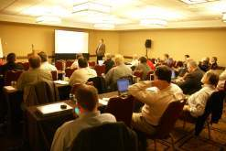
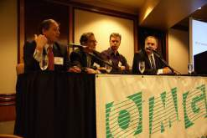
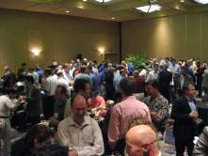
Who Is OMG?
Object Management Group (OMG):
Founded in 1989
More than 470 member companies
The largest and longest standing not-for-profit, open-membership consortium which develops and maintains computer industry specifications.
Continuously evolving to remain current while retaining a position of thought leadership.
Notes:
Which are membership requests, submits, develops and maintains To help achieve the objectives of Reusability, interoperability and portability
These standards are requested, submitted, adopted and maintained by the membership.

Slide 18




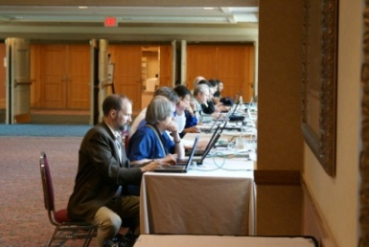
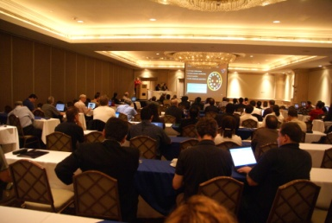
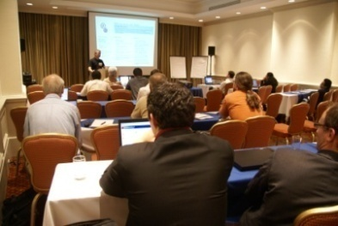
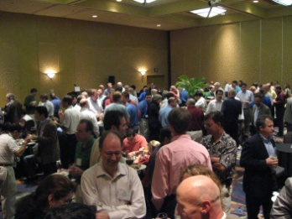
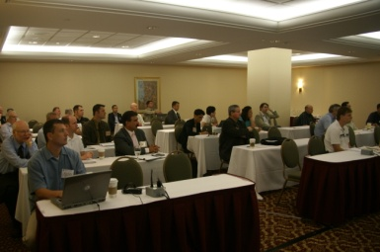
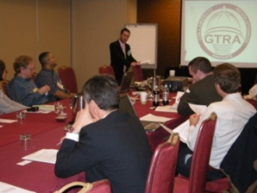
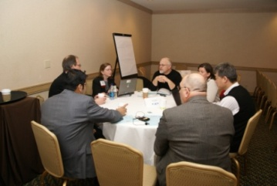
Developing Standards
Standards are developed using OMG’s mature, worldwide, open development process. With over 20 years of standards work, OMG’s one-organization, one-vote policy ensures that every vendor and end-user, large and small, has an effective voice in the process.
Notes:
18

Slide 19






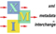
OMG’s Best-Known Successes
Common Object Request Broker Architecture
CORBA® remains the only language- and platform-neutral interoperability standard
Unified Modeling Language
UML® remains the world’s only standardized modeling language
Business Process Modeling Notation
BPMNTM provides businesses with the capability of understanding their internal business procedures
Common Warehouse Metamodel
CWMTM, the integration of the last two data warehousing initiatives
Meta-Object Facility
MOFTM, the repository standard
XML Metadata Interchange
XMI®, the XML-UML standard

Slide 20
Scope of OMG RFP
Wide & shallow conceptual model generically covering threats and risks
Other risks (Out of scope)
Operational Threat & Risk Concepts
High level Cyber-threat/risk concepts
Law Enforcement / Emergency Management Concepts
Physical. Spectrum, facilities,
Probabilities, Forensic, Chemical, Biological, Medical, Nuclear, Military and Intelligence threats concepts
STIX/TAXII/Cybox
IODEF
SACM
ISO
NIST
Others…
NIEM Threat/Risk Representation
Other Risks
Systemic Risk
Credit Risk
Market Risk
Pension Risk
Reputation Risk
Liquidity Risk
Legal Risk
Project Management Risk
Legend
Normative
(Formal Specification)
NIEM Exchanges
EDXL / CAP
Others…
Other Inputs
In Scope with Limited Detail
Informative

Slide 21
Team Threat
Team threat is the submission team developing the specification.
The “formal” submitters are OMG platform or contributing members
We are a very open submission team, we invite participation by stakeholders
Comment on the specification
Provide use cases
Help author the specification
Work with other communities and standards groups (e.g. Oasis CTI/STIX (Cyber) and Emergency Management).
Collaborative implementation efforts
Funding

Slide 22
Submitters and Contributors (Thus Far)
Information Sharing Environment (ise.gov)
Demandware
U.S. Air force
U.S. Defense Security Services
California Public Safety (http://www.Caloes.ca.gov)
U.S. National Information Sharing Model PMO (https://www.niem.gov/)
Duke Energy
NSA/UCDMO
NIST
INCOSE
Integrated Networking Technologies, Inc.
Tibco Software Inc.
Hitachi
NC4
Others pending approval
Model Driven Solutions division of Data Access Technologies
KDM Analytics, Inc.
International Business Machines, Inc.
RSA, The Security Division of EMC
Lockheed Martin, Inc.
Oracle Corporation
Fujitsu
Team Threat

Slide 23
Summary Of OMG RFP Process
Task force identifies need
Task force proposes RFP to be issued, goes through OMG process
Submission team(s) form to produce proposed specification(s)
Two or more revision cycles propose specifications
Through rigorous process, OMG adopts “Beta” specification
You
Are
Here
Finalization task force forms, works to resolve any implementation issues
Issues are addressed, final adopted specification proposed.
Adoption of final speciation through OMG process.

Slide 24
Status
Threat Modeling project kicked off in Dec 2013
Initial submission was made May 2015
Revised Submission November 2015, to be presented at December OMG meeting
Next (and probably final) revised submission TBD: Early to mid 2016
Full adoption by OMG Board of Directors: Mid to late 2016
Implementation efforts need not wait, draft specification can (and should) be implemented to validate the proposed standard.

Slide 25
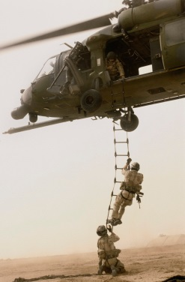
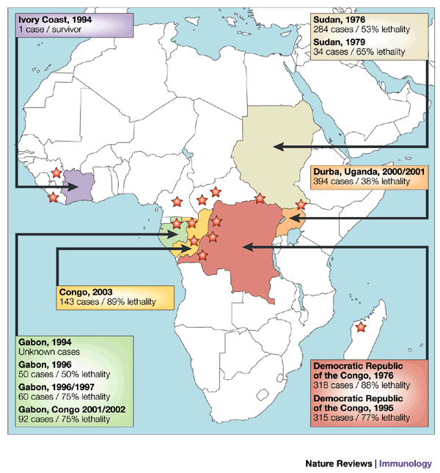

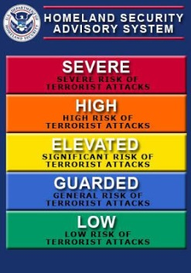



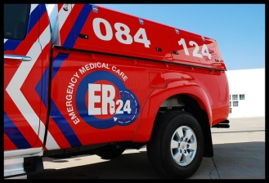


Stakeholder roles in our community
Risk/Threat
Information Sources
Data Fusion
& Brokers
Analysts
Defenders
Responders
Vendors & Service Providers
One organization may play multiple roles

Slide 26
Use Case: Large Company
Company with multiple datacenters, office facilities, international business activity
Large number of deployed security systems, sensors
Firewalls, IDS/IPS, SIEM, monitoring systems, notification/alerting, etc.
Uses FW/Snort rules, STIX/TAXII, IODef, alarms for fire and intrusions, etc.
Physical and information security staff, some 24/7
Interoperable (but not uniform) threat monitoring and assessment

Slide 27
Use Case – Critical Infrastructure
Target: A group of organizations that collaboratively manage critical infrastructure and utilize Industrial Control Systems.
Power, water and other critical infrastructure are threatened by cyber and physical terrorism.
Industrial Control Systems are increasingly computer controlled and connected (directly or indirectly) to the internet and may embed compromised control hardware/software from questionable sources.

Slide 28




Potential Information Flows
Suspicious Activity Report
NIEM
Incident
Arrest Report
STIX Incident
Tactical Response Unit
Fusion Center
Intelligence
Report
IT System Hardening
Manual Shutdown
Public CAP Warning

Slide 29

Example - Snowmageddon
In January 2015 Massachusetts faced the Hazard of major winter storms across the region. Potential Harm from blizzards and winter storms includes negative economic impact, limited road accessibility, restricted emergency management, non-availability of utility, property damage, personal injury and death, and more.
The onset of a winter storm or blizzard was predicted by the National Weather Service (NWS).

Slide 30
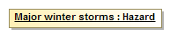
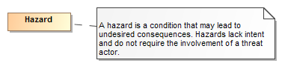
Example of structuring risk information
In January 2015 Massachusetts faced the Hazard of major winter storms across the region.
Is formalized as
Is defined by
A data syntax and vocabulary
Maps To
<drn:PotentialDanger>Major winter storms</drn:PotentialDanger>

Slide 31
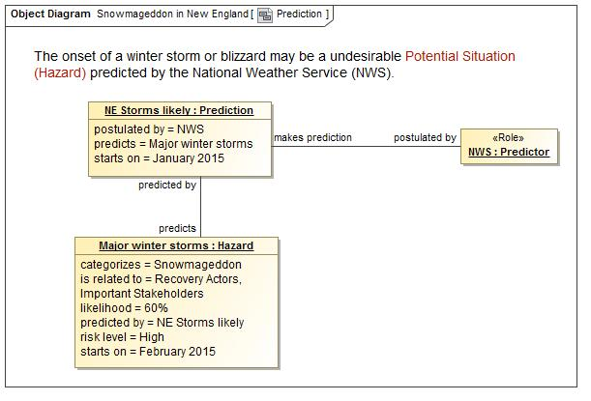
A Potential Storm? Who said this?

Slide 32
Precepts
The purpose/organizational/technology specific schema will not (should not) go away
A “one size fits all” solution will not work
There will be no one technology
There will be no one terminology or language
There will be no one data structure for threats and risks
Our focus is federation
Understanding the concepts behind the schema
Mapping them to/through a common conceptual model
Enabling interoperability by bridging between the specific schema
Supporting integration and coordination of mitigation and response capabilities

Slide 33
Core Concept: Comprehending Planned and Unplanned Threats
“All hazards” include man-made and natural disasters/system failures
There is not always an actor involved (e.g. hurricane, system malfunction)
Intentional threat actors are not the only source of threats
Non-malicious actors may constitute significant threat (e.g. spear-phishing victim, power plant operator)
Defenders (e.g. system admins, law enforcement, medical staff) are also actors with defensive plans
Victims are actors as well

Slide 34

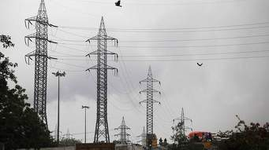
Core Concept: Attacker/Defender Symmetry
Attack perspective:
Defender: Attackers/hazards are threats
Attacker: Targets are opportunities
Defense perspective:
Attacker: Successful defense is a threat to the intentions/objectives
Defender: Maintaining effective defensive posture is an opportunity
Threat vs. Opportunity is in the eye of the emoticon – it is not sufficient to create static classifications
Opportunity!
Capability to disrupt the power grid
Threat!
Notes:
One mans risk is another mans opportunity
The same risk/threat/incident needs to be understood from very different perspectives
Classifying something as a risk/threat/incident or mitigation only makes sense with respect to how it impacts the objectives of some stakeholder. E.g “a risk of damage to the U.S. power grid impacting millions”.
The conceptual model supports this separation while mapping to structures that assume a particular perspective.

Slide 35
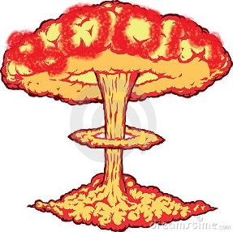


Danger lifecycle
Intent
Threat Actor
Plan
Capability
Act
Potential Effect
Real World Effect
Vulnerability
Risk
Threat
Incident
Consequence
Impact on Objectives
Stakeholder
Natural event or System failure
Potential Harm
Harmful Event

Slide 36
Understanding the models

Slide 37
Kinds of models
Conceptual models
Defines the terms and concepts of the threat & risk domain as a semantic model. Conceptual models can also be transformed to ontologies.
Data models
Represents specific logical or physical data schema for a specific purpose – more concrete and structured.
Data models are a direct representation of some kind of schema, e.g. XML Schema, SQL Schema or RDF Schema.
Mappings
Mappings relate a data model to one or more conceptual models to provide for automated transformation and federation of information in these deferent formats.
The conceptual models become the “pivot point” between multiple data representations of the same and related concepts.

Slide 38
Pivoting Through a Conceptual Model
“Source”
Data
Representation
Data representations (Schema & Instances)
Model data for a purpose using a technology
“Instances” are data structures (e.g. SQL tables or XML documents) – “facts” about the things in the world from some perspective
Conceptual Domain Models (CDM)
A conception of the world by a group of stakeholders – less purpose specific
“Instances” are things in the world – so can’t be in models
Using abstraction, we can have multiple representations of facts about the world in different data structures and technologies
Rules define how domain concepts can be represented in a particular form – rules can be simple and generic or heavyweight and specific, depending on the representation.
“Target”
Data
Representation
Represent
Rules
Conceptual Domain Models
(Models of the world)

Slide 39
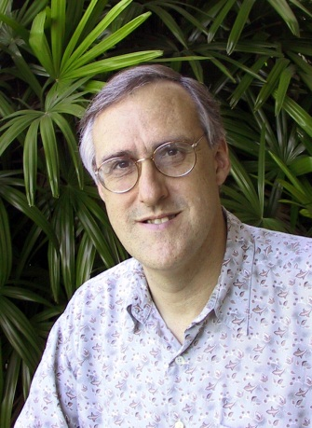
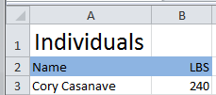
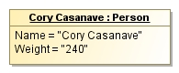
Example of “Pivoting” through a conceptual model
Concept of
“Cory Casanave”
There is an actual “Person”, Cory Casanave
There is a concept of this person shared in this room, right now
Here is one representation of him
“Person” is a shared concept, independent of data structures
There may also be shared agreement that Cory is a person and some other “facts”
“Cory Casanave” is a name for this person
He weighs 240 LBS
There are multiple data representations about Cory Casanave which may or may not agree
Those representations can be grounded in concepts (semantics), assisting federation
Concept of a
“Person”
<PersonType>
<NameText>Cory B. Casanave</NameText>
<Weight-LBS>234</Weight-LBS>
</PersonType>
XML
Representations
.
Excel
UML

Slide 40
Critical Components – conceptual models and mappings
External
Conceptual Modeling Profile
Mapping Profile
XSD Profile
Depends On
Uses
Uses
Uses
Uses
Generic and threat-risk conceptual models
STIX/Cybox Mapping
STIX/Cybox UML XSD Import
NIEM Mapping
NIEM-UML
More…
More…

Slide 41
Example
STIX Incident Data
STIX IncidentType
(XSD)
NIEM IncidentType
(XSD)
NIEM Incident Data
Map
Map
Concept of an Incident
(UML)
Threat/Risk Implementation
Federated Incident Analytics

Slide 42
Mappings included
STIX – Structured Threat Information Exchange, for Cyber threat information. (Moving to Oasis “CTI”)
NIEM – National Information Exchange Model – For justice, public safety and other domains.
Risk Model – A concrete risk model for data interchange is included and mapped as none currently exists as a standard.
NIST 800-53 – Security and Privacy Controls for information systems. This is not a data mapping but shows how the concepts support the controls.
Note: More mappings are anticipated as the initiative unfolds. Some may be published but not standardized.

Slide 43
How models are represented

Slide 44
Use of UML
The threat/risk submission uses the Unified Modeling Language (UML) for all three kinds of models: Conceptual, data and mapping
Many know UML as primarily an object oriented software design language
The use of UML has grown in scope, the use for conceptual models, system engineering and mappings is becoming mainstream.
The UML notation is well known and understood
The tools are mature
It is not bound to a particular technology, models are mapped to technology implementations like XML, OWL or C#
Threat/risk uses another in-progress OMG specification “Semantic Information Modeling for Federation” (SIMF), which defines UML “Profiles” and meta-models for conceptual modeling and mapping.

Slide 45
Isn’t this an Ontology?
A conceptual model as we have defined it is much like the “classic” definition of an ontology as a formal definition of how things are conceived.
There is also the “marketplace” definition of Ontology, which implies specific languages with specific features to support specific kinds of inference engines. Much of the attention is on “OWL”, but many formal Ontologists use “Common Logic” , “KIF” and other math based languages. None of these have a friendly graphical representation or user friendly tools.
OWL in particular constrains the way concepts are defined, to support Tableau reasoner engines. The kind of inference central to us, data mapping, is not well supported by tableau and is only research in other ontology languages. OWL is a grat platform language for supporting inference.
We find the term “Conceptual Model” better relates to how stakeholders think about their domain and their problem, using diagrams and tables. The rules defined leverage this conceptual model and are targeted specifically to solve the mapping problem.
So yes, a conceptual model is an ontology in the general sense. We can even generate OWL. But it is not natively an OWL ontology nor is it constrained to the limitations of OWL or first order logic.

Slide 46
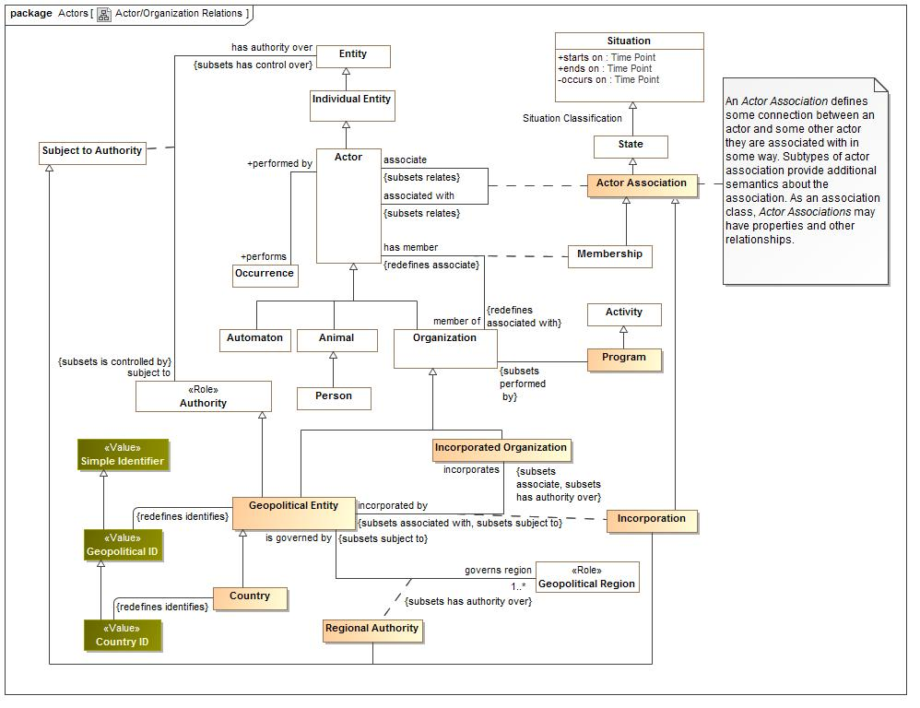
Example UML

Slide 47
UML Concepts we use
Classes {Entities}
Data types and primitive types {Values}
Associations, associations ends {Relation types}
Properties for values {Simple property relations}
Property defaults {Refinement: An expression evaluated if no values set in context}
Association classes (However, all associations and properties are considered “first class” and can have metadata and time properties)
Subsets and redefines of association ends {Properties of relations}
Cardinalities {Constraint}
Packages & Package URI {Lexical and logical context}
Realization {Representation realizes concept}
Structured Classifier {Patterns and rules}

Slide 48
Profile extension concepts
Classifying packages
Conceptual Model, Physical Model, Mapping
Classification / classifies
Role & Phase
Kinds of types
Entity, Quantity Kind, Unit
Relations
Disjoint with
Represents (mapping)
Representation Rule & Map {Mapping}

Slide 49
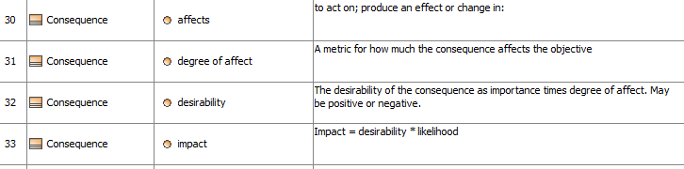
Representing the data and schema
Options
UML Diagrams
Tables
Schema
UML is about the information and semantics, not the diagrams. The diagrams and tables support communication of the concepts.

Slide 50
Modeling Convention – General Relations
In the conceptual model
In a representation (E.G. STIX)
It is typical in a data model and some ontologies to have many specializations for the same relation concept, but different “end types”.
In the conceptual model we have the general concept “relates <Anything>”.
“represents” semantics say that a general relation is only mapped to a more specific representation if the ends of that relation representation also represent the correct end types.
So, one general type covers many more specific relations and properties.
RelatedCampaign <Campaign>
RelatedIndicators <Indicator>
RelatedTTP <TTP>
The pattern is: Related<type> <type>
Etc…
All the above Represent “relates <Anything>”

Slide 51
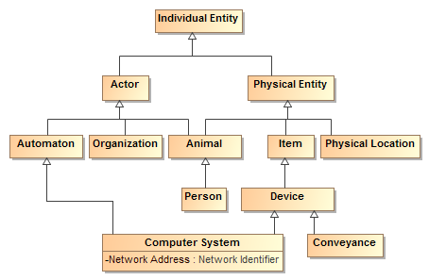
Class Hierarchies

Slide 52
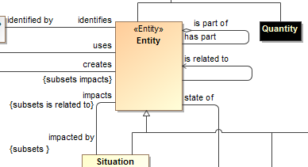
Hierarchy of verb and property concepts
Like types, verbs and relation roles can also form a hierarch and specialize each other
This is defined with UML “subsets” and Redefines”
Subsets defines a refinement of another end, but still allows the original definition
Redefines does not allow the original definition in the new context
This is like “subproperty” in OWL and RDF

Slide 53
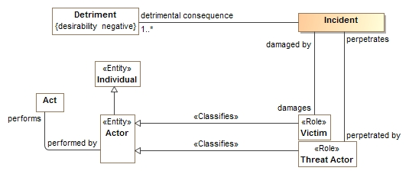
Roles
Roles define what something is for or how it behaves in a certain context, not “what it is”.
A role <<Classifies>> what it can be a role of.
An entity can play any umber of roles and these roles may change over time.
Roles can be contextual

Slide 54
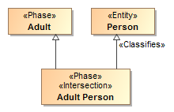
Phases
Phases (or states) are classifications of objects over their lifetime.
Examples: Child, Teenager, Adult or Invoiced, Late, Paid

Slide 55
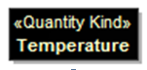
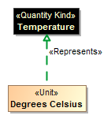
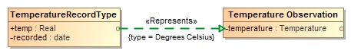
Quantity Kinds
For numeric properties, we want to know what it means (e.g. Temperature), not the kind of number (Real).
<<Quantity Kind>> is an aspect common to mutually comparable quantities represented by one or more units.
A unit represents a quantity kind, there are multiple units representing temperature.
A physical representation would then represent the unit as some kind of number in a specified unit.

Slide 56
Threat/Risk Conceptual Model
Examples of specific risk/threat concepts – intended to show how the conceptual model is being produced

Slide 57
Conceptual Model Layering
Operational threat situational awareness and response
Operational risk evaluation and mediation
Cross-risk/threat – specific “wide and shallow” risk and threat concepts/ E.G. Risk, threat, danger, consequence
Generic Library – Provides concepts and links across multiple viewpoints, not just threat/risk. E.G. Person, Objective
Kernel– Foundational concepts for modeling anything: Entities, Roles, Relations, Types, Information, Rules, Identity, Etc…
Subset of the model from SIMF

Slide 58
Conceptual Model Packages
Core Concepts
Foundation
Identifiers
Information
Patterns
Process
Quantities and Units
Rules
Situations
Timeframe
Generic Concepts
Ability
Actors
Assessment
Control
Credentials
Enterprise
Entity Kinds
Intent
Location
Observation
Organization
Person
Prediction
Resources
Systems
Threat and Risk Specific Concepts
Campaign
Course of Action
Cyber
Danger Categories
Incident
Indicator
Kill Chain
Mitigation
Risk Treatment
Threat
Undesirable Situations
Vulnerability

Slide 59
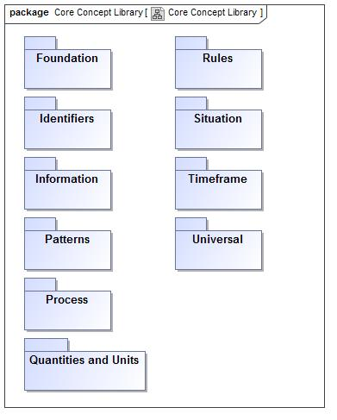
Core Concept Library

Slide 60
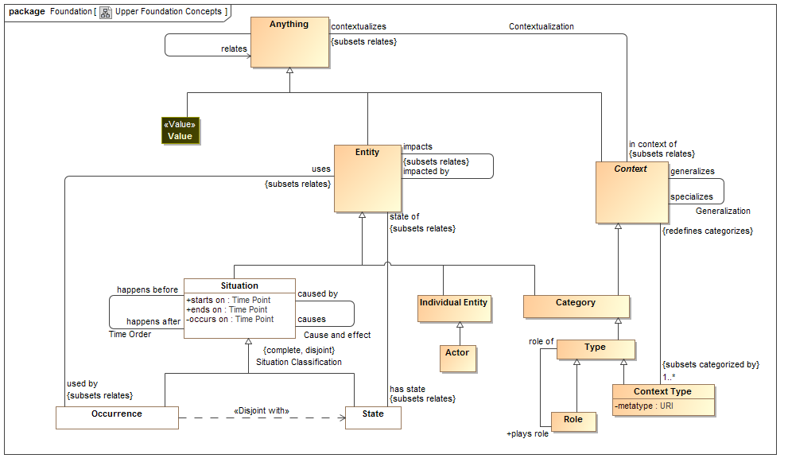
Upper Foundation

Slide 61
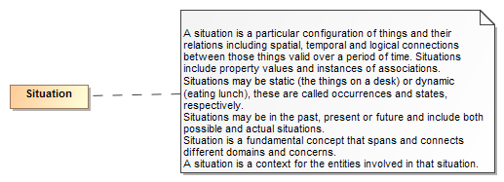
Threats and Risks of What?
A threat or risk is with respect to some undesirable situation
What is a situation?
We define a situation as a configuration of things…
People places, things, events, occurrences and the connections between them.
Some situations are consequences of others
Situations provide a link between different kinds and phases of threats & risks

Slide 62
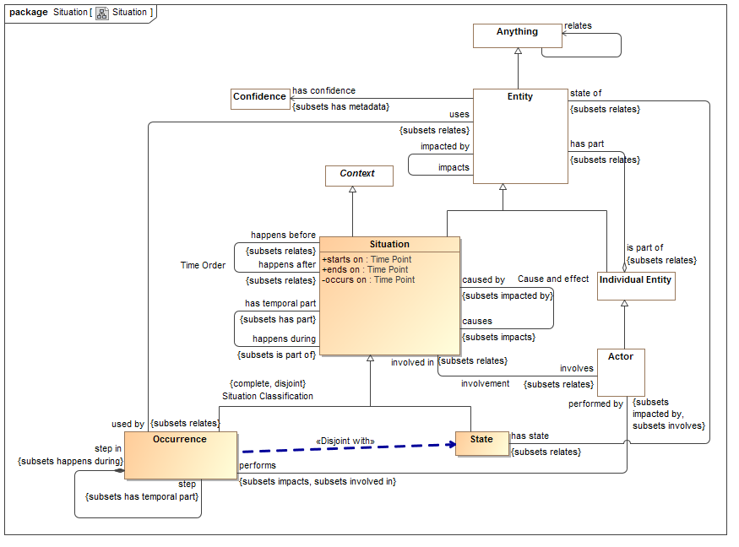
Situations

Slide 63
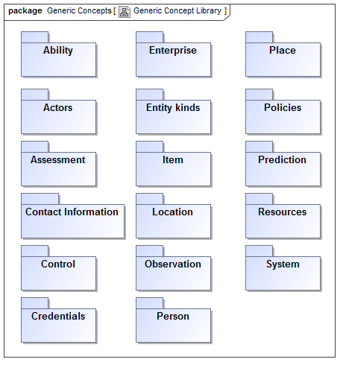
Generic Library

Slide 64
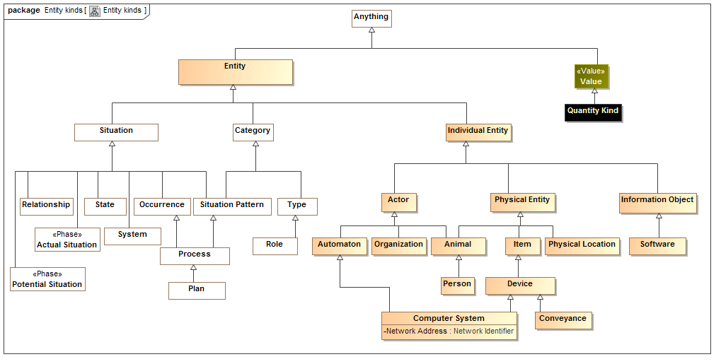
Entity Kinds

Slide 65
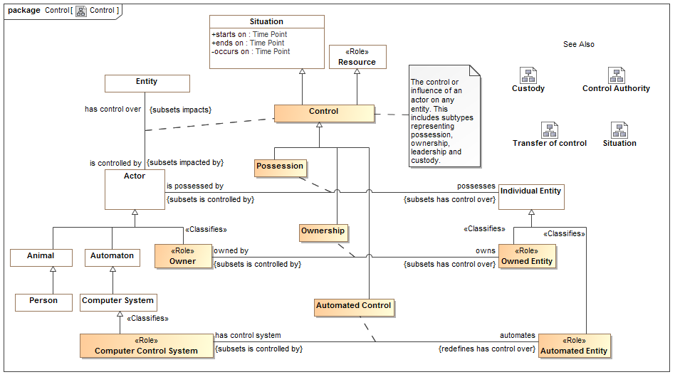
Control

Slide 66
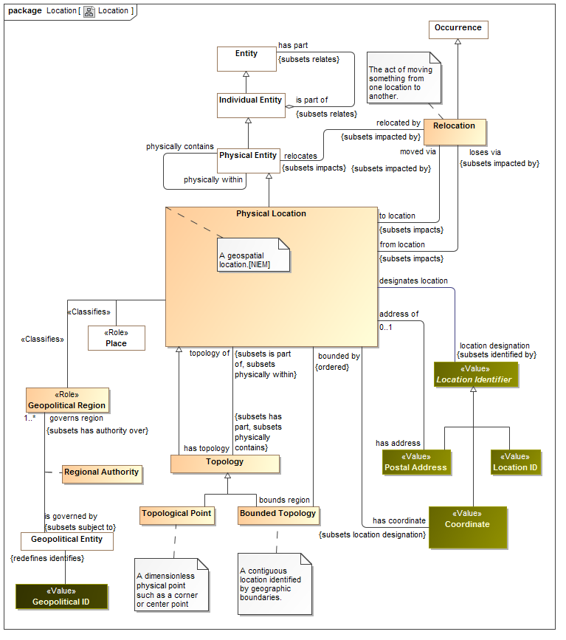

Slide 67
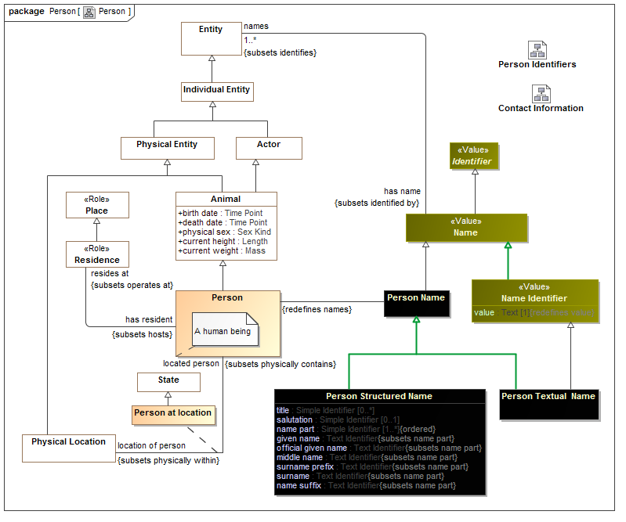
Person

Slide 68
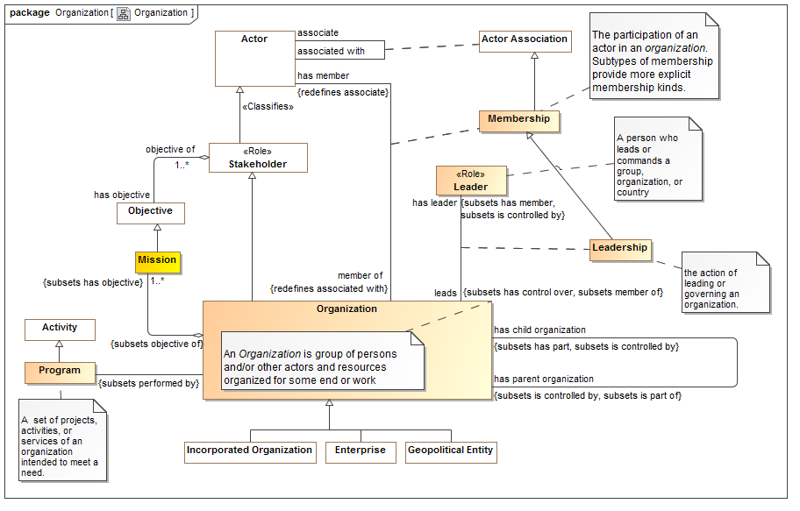
Organization

Slide 69
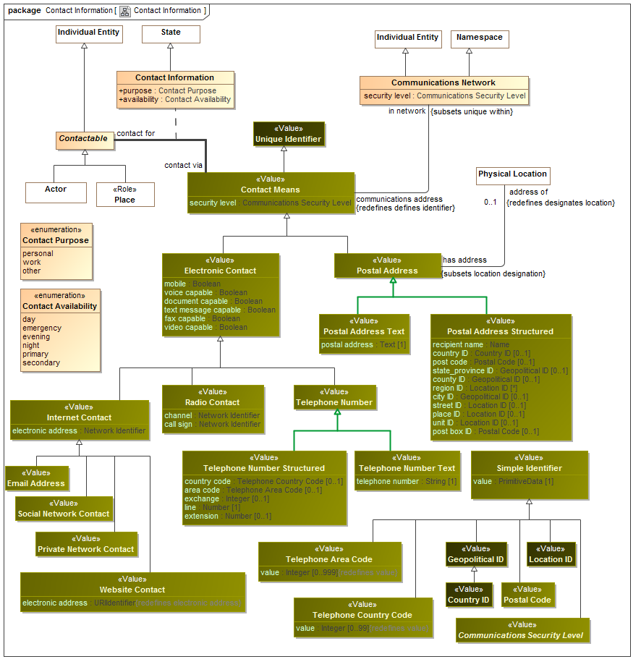

Slide 70
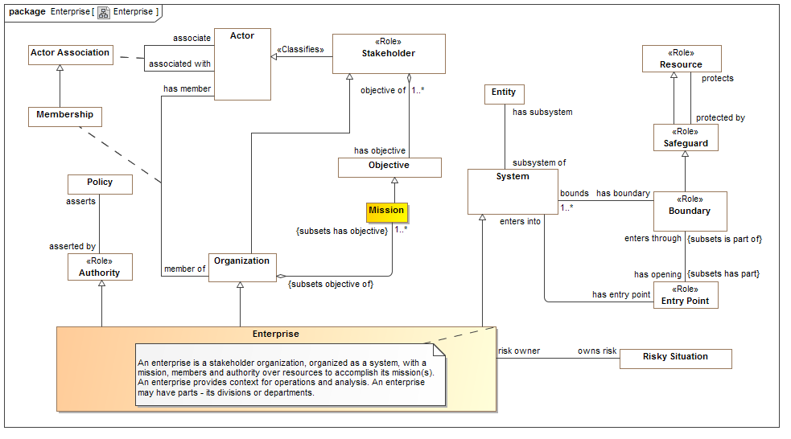
Enterprise

Slide 71
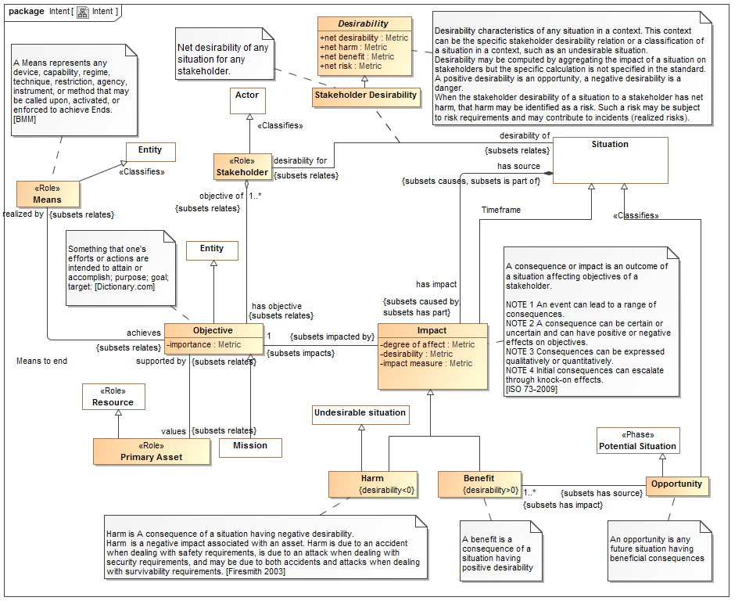

Slide 72
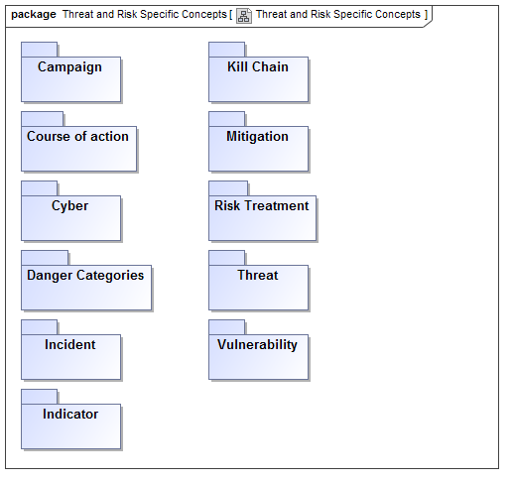
Threat & Risk Specific Concepts

Slide 73
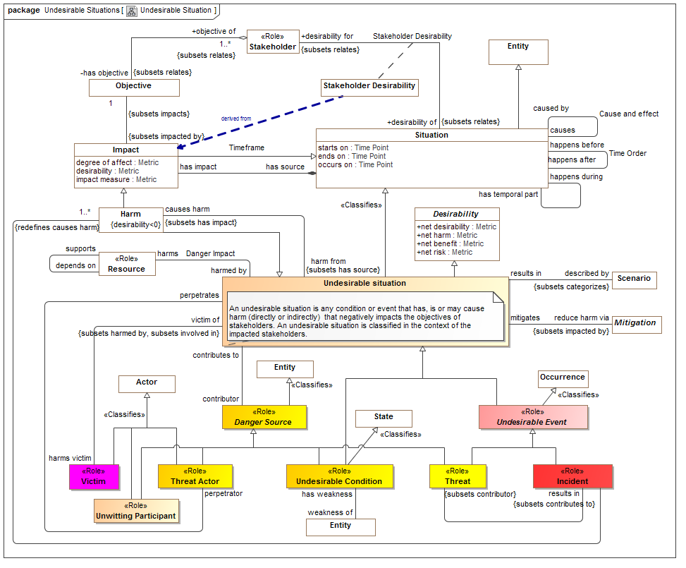

Slide 74

Danger Categories

Slide 75

Vulnerability

Slide 76

Threat

Slide 77

Indicator

Slide 78

Indicator Kinds

Slide 79

Sighting & Observation

Slide 80


Slide 81


Slide 82


Slide 83

Risk Treatment

Slide 84
Mapping Semantics
High-level mapping as “represents” relations at the type level
Detail mappings as template patterns using UML
Mappings are bi-directional

Slide 85

Representing the STIX physical model
<xs:complexContent>
<xs:extension base="stixCommon:IndicatorBaseType">
<xs:sequence>
<xs:element name="Title" type="xs:string" minOccurs="0">
<xs:annotation>
<xs:documentation>The Title field provides a simple title for this Indicator.</xs:documentation>
</xs:annotation>
</xs:element>
<xs:element name="Type" type="stixCommon:ControlledVocabularyStringType" minOccurs="0" maxOccurs="unbounded">
<xs:annotation>
<xs:documentation>Specifies the type or types for this Indicator.</xs:documentation>
<xs:documentation>This field is implemented through the xsi:type controlled vocabulary extension mechanism. The default vocabulary type is IndicatorTypeVocabularyType in the http://stix.mitre.org/default_vocabularies-1 namespace. This type is defined in the stix_default_vocabularies.xsd file or at the URL http://stix.mitre.org/XMLSchema/default_vocabularies/1.1.1/stix_default_vocabularies.xsd.</xs:documentation>
<xs:documentation>Users may also define their own vocabulary using the type extension mechanism, specify a vocabulary name and reference using the attributes, or simply use this as a string field.</xs:documentation>
</xs:annotation>
</xs:element>
<xs:element name="Alternative_ID" type="xs:string" minOccurs="0" maxOccurs="unbounded">
<xs:annotation>
<xs:documentation>Specifies an alternative identifier (or alias) for the cyber threat Indicator.</
XML Schema is reverse engineered into UML. Next version of STIX will have native UML model.

Slide 86

XML Element represents concept
Mapping
Rule
Represents
STIX XSD
Concepts
Green line is “Represents”
Rules specify mapping details

Slide 87


Slide 88


Slide 89
Example STIX source data
<stix:Incident id="example:incident-fd56fb34-af59-47b3-95cf-7baaaa53fe93" timestamp="2014-08-28T16:42:52.859547+00:00" xsi:type='incident:IncidentType' version="1.1.1">
<incident:Title>Breach of Canary Corp</incident:Title>
<incident:Time>
<incident:Incident_Discovery precision="second">2013-01-13T00:00:00</incident:Incident_Discovery>
</incident:Time>
<incident:Description>Intrusion into enterprise network</incident:Description>
<incident:Reporter>
<stixCommon:Description>The person who reported it</stixCommon:Description>
<stixCommon:Identity id="example:Identity-5db269cf-e603-4df9-ae8c-51ff295abfaa">
<stixCommon:Name>Sample Investigations, LLC</stixCommon:Name>
</stixCommon:Identity>
<stixCommon:Time>
<cyboxCommon:Produced_Time>2014-03-11T00:00:00</cyboxCommon:Produced_Time>
</stixCommon:Time>
</incident:Reporter>
<incident:Victim id="example:Identity-c85082f3-bc04-43c8-a000-e0c1d0f2c045">
<stixCommon:Name>Canary Corp</stixCommon:Name>
</incident:Victim>
<incident:Impact_Assessment>
<incident:Effects>
<incident:Effect xsi:type="stixVocabs:IncidentEffectVocab-1.0">Financial Loss</incident:Effect>
</incident:Effects>
</incident:Impact_Assessment>
<incident:Confidence timestamp="2014-08-28T16:42:52.859570+00:00">
<stixCommon:Value xsi:type="stixVocabs:HighMediumLowVocab-1.0">High</stixCommon:Value>
</incident:Confidence>
</stix:Incident>

Slide 90

Example of mapped data graph
Provenance

Slide 91

NIEM Mapping summary (1)

Slide 92

NIEM Mapping summary (2)

Slide 93


Slide 94

NIST 800-53 Mapping (Example)

Slide 95

Risk Profile
The risk profile provides a “UML” way to define the risks of a system. These system & enterprise risks can then populate the threat/risk model.

Slide 96
Implementation Options

Slide 97
What does implementation mean?
That threat & risk information can be translated, federated or analyzed.
The conceptual model may
Be only “virtual”, rules govern the transforms between “ends”
Be implemented in some repository – most likely a graph database
Executable may
Be generated, e.g. production of Java and/or XSLT
Dynamic – direction execution of model components (code attached to various model metatypes)
Use cases may include
Data translation
Common repository for analytics
Simulation

Slide 98
Implementation we are focusing on
Validation of the model with real data
Bring data into a graph repository
Analytics on federated repository
Ability to publish data out in other formats

Slide 99
Prototyping
Prototype is intended to validate models and mappings, it is not efficient or production code (yet). It is implemented in Python and all data is in-memory

Slide 100
Prototype Design
Magicdraw
Currently just does STIX
Conceptual
Model
STIX
XML
SIMF-Python Interpret / Export
Python Mapping Code
Files From Model
Rules
Output
Dictionary Spreadsheet
(Concept Labels)
SIMF/ Python Objects
Map rules
SIMF-XML
Objects
Object
Graph
Map log
(Data seen and mapped or not)
Extend
Rules

Slide 101
Example Dictionary
Dictionary
Example
From Model
Entity kinds/Physical Entity | A thing that has mass and takes up space including people, places and things.
UML2 Metamodel/Generalization
Intent/has intent
Context/Type
RiskThreat/has sighting
Possession/possesses
RiskThreat/damages

Slide 102
Map log example
What was mapped to what
MAP:/stix/core/stix_package/STIXPackage.indicators---MAPPED TO---><Indicator "opensource:indicator-45c112fa-805f-4cc0-b17b-2d98b519ca60" as "defines">
NO VALUE FOR RULE:/stix/core/stix_package/STIXPackage.incidents
NO VALUE FOR RULE:/stix/core/stix_package/STIXPackage.ttps
MAP:/stix/base/Entity.id_---MAPPED TO---><"edge:Package-3ffdccc7-bd56-4491-88d1-be3d966e42f8" as "identified by">
NO VALUE FOR RULE:/stix/base/Entity.idref
NO VALUE FOR RULE:/stix/base/Entity.title
NO VALUE FOR RULE:/stix/base/Entity.description.value
------UNMAPPED properties and get methods-------
IN:/stix/core/stix_package/STIXPackage.version = 1.1.1
IN:/stix/core/stix_package/STIXPackage.related_packages = None
IN:/stix/core/stix_package/STIXPackage.timestamp = 2014-11-23 00:12:45.650946+00:00
IN:/stix/core/stix_package/STIXPackage.campaigns = []
Input data to consider

Slide 103
Example rules*
Represents("/stix/ttp/TTP", "Behavior/Modus Operandi")
Represents("/stix/ttp/TTP.behavior", "Core Concepts/step")
Represents("/stix/ttp/behavior/Behavior", "Process/Plan")
Represents("/stix/ttp/behavior/Behavior.malware", "Process/requires")
Represents("/cybox/common/datetimewithprecision/DateTimeWithPrecision",
"Quantities and units/Time point")
Represents("/cybox/common/datetimewithprecision/DateTimeWithPrecision.value", "Quantity/value")
#Entity properties used for all subtypes
RepresentsID("/stix/base/Entity.id_", "Core Concepts/identified by")
RepresentsID("/stix/base/Entity.idref", "Core Concepts/identified by")
Represents("/stix/base/Entity.title", "Information/has name")
Represents("/stix/base/Entity.description.value", "Information/described by")
From schema and map log
From conceptual dictionary
* Currently in text format

Slide 104

Resulting data graph

Slide 105
Questions, comments discussion

Slide 106
Extra Stuff
Detail Backup for presentation

Slide 107
All Threat/Risk Model Diagrams
The following are for reference and not intended to be individually presented

Slide 108
UML Profile

Slide 109

Conceptual modeling profile

Slide 110

Consistency Rules profile

Slide 111
Conceptual Model

Slide 112
Core Concept Library

Slide 113

Upper Foundation Concepts

Slide 114

Anything Detail

Slide 115

Entity Detail

Slide 116

Individual Detail

Slide 117

Situation

Slide 118

Patterns

Slide 119

Process and plans

Slide 120

Type Detail

Slide 121

Timeframe

Slide 122

Rules

Slide 123

Information

Slide 124

Identifiers

Slide 125

Binding Detail

Slide 126

Universal

Slide 127

Generic Concept Library

Slide 128

Entity kinds

Slide 129

Ability

Slide 130

Actor Detail

Slide 131
Actor/Organization Relations

Slide 132

Actor Identifiers

Slide 133

Credentials and managed identifiers

Slide 134

Contact Information

Slide 135

Animal Detail

Slide 136

Assessment

Slide 137

Control

Slide 138

Control Authority

Slide 139

Transfer of control

Slide 140

Custody

Slide 141

Enterprise

Slide 142

Intent

Slide 143

Impact

Slide 144

Impact Detail

Slide 145

Opportunity

Slide 146

Item

Slide 147

Location

Slide 148

Location Identification

Slide 149

Place

Slide 150

Observation

Slide 151

Observability

Slide 152

Organization

Slide 153

Person

Slide 154

Person Identifiers

Slide 155

Physical Entity Detail

Slide 156

Policy

Slide 157

Prediction

Slide 158

Resource

Slide 159

Sighting

Slide 160

Sighting Detail

Slide 161

System

Slide 162

Quantities and units

Slide 163

Quantity Kinds

Slide 164

Common Units 1

Slide 165

Common Units 2

Slide 166

Threat and Risk Specific Concepts

Slide 167

Undesirable Situation

Slide 168

Undesirable Detail

Slide 169

Threat

Slide 170

Danger Categories

Slide 171

Campaign

Slide 172

Kill Chain

Slide 173

Vulnerability

Slide 174

Risk Treatment

Slide 175

Indicator

Slide 176

Indicator Kinds

Slide 177

Mitigation

Slide 178

Incident

Slide 179

Course of Action

Slide 180

Cyber

Slide 181
Threat/Risk RFP Requirements
The following shows how the submission meets the OMG RFP Requirements

Slide 182
Conceptual Models
Submissions shall define modular UML conceptual models to specify the concepts required to represent information about operational threats and risks.
The conceptual model shall capture the intended meaning of operational threat and risk related concepts such that it may be used as a reference for the use of those concepts in specific exchanges and data stores.
The conceptual model shall not assume any particular technology, domain, representation, structure of information or schema. It shall be a model of the concepts representing real-world entities, not of a specific data representation.
Covered

Slide 183
Threat/Risk Concepts To Define
Operational Threat
Operational Risk
Asset
Campaign
Cause
Effect
Exploit target
Goal
Hazard
Impact
Incident
Indicator
Likelihood
Mitigation
Observable
Observation
Observation Metadata
Procedures
Risk
Safeguard
Severity
Strategy
Tactics
Techniques
Threat
Threat actor
Threat source
Undesired event
Covered

Slide 184
Classes of Threat/Risks in scope
Cyber/information and communication systems and assets
Physical systems and assets, including embedded and manufacturing
Electromagnetic spectrum assets (E.g. interference with wireless systems or radio)
Industrial control systems
Covered

Slide 185
Constraints
Defensive, offensive, or other actors may or may not have insight into the plans or strategies of the respective other actors. As such, model implementations will in those cases be incomplete and rely on estimates and assumed parameters.
Models must be able to support non-actor threats (such as natural disasters ) that will not be associated with any coherent intentions or plans.
Bystanders and inadvertent actors may perform actions that result in behavior that provides benefits to any other actor (offensive or defensive). Such actions are understood to be non-intentional.
The focus of risks will be those that go beyond the normal course of business and expose the enterprise to increased risk due to threats & vulnerabilities.
Unclear what level of behavioural modeling you have in mind, but in general it could be expected that an offensive actor would have an understanding of the plans of defensive actors [Done-CBC (Also MH)]
6.5.2.5 Models for operational threats and risks shall include concepts for expressing probability and/or confidence levels (e.g. for likelihood of occurrence and impact)
The conceptual model shall include concepts for understanding, planning for and treating operational risks, threats and their contingencies at the governmental and enterprise level.
Covered

Slide 186
NIEM Representation & Mapping
Submissions shall define a normative NIEM-UML PIM representation sufficient to capture the concepts as defined in the conceptual models as defined above.
This NIEM-UML representation shall be mapped to the conceptual models such that the meaning of each threat/risk relevant NIEM element is described in the conceptual model.
The mapping shall be sufficiently expressive such that any set of instances represented in or logically mapped to the conceptual model shall be able to be represented in NIEM (understanding that choices and rules will have to be made).
Any instance of the NIEM specification shall be able to be logically mapped to the conceptual model.
Covered

Slide 187
STIX Mapping
Submissions shall define a mapping to the subset of STIX that corresponds with the conceptual model. This mapping shall demonstrate that the conceptual model is sufficient to represent high-level STIX concepts.
Covered
(Next rev expected)

Slide 188
Common Requirements
All models shall utilize UML and UML profiles as a foundation.
Concepts that are required for understanding threats or risks should, as much as possible, be defined in a modular fashion such that these concepts may be reused for related threat/risk concepts NIEM and other reference models shall be used as a reference for such cross-domain concepts.
Covered

Slide 189
Optional Mappings
Submissions may provide normative or non-normative mappings to support the following Platform Specific Models, or logical models for the following protocols or communities:
OASIS Common Alerting Program & EDXL
Others as deemed important by submitters
EDXL and others as input
Mappings anticipated

Slide 190
Optional support for conceptual modeling and mapping
Submissions may reference and/or define non-normative UML profiles and associated QVT (or other ways to express mapping logic) for conceptual modeling and the mapping.
Submitters are encouraged to follow the progress of and use as appropriate SIMF, ODM, MDMI, semantic web and other efforts to help define conceptual models and mappings.
Covered - SIMF

Slide 191
MOF Representation
Submissions may define A MOF metamodel that utilizes the conceptual model and provides an XMI representation of Operational Threats and Risks.
Covered
Using UML

